Slide 1
WORKSHOP ON INTERNET OF THINGS 67612 Exercise 4
Internet over cellular
Prof. David Hay, Dr. Yair Poleg, MR. Samyon Ristov

Slide 2
The Exercise
Initiate an internet connection
Send HTTP POST requests to an HTTP server
Print on the LCD the progress of the transmission
Tie it all together, and send GPS data in InfluxDB Line Protocol format, as POST requests, to an HTTP server

Slide 3
Guidance
Follow Cinterion EHS6 AT Command Set. You can start with chapter 10, Internet Service Commands, page 217
Commands to pay at special attention to: AT^SICS, AT^SISS, AT^SICI, AT^SISO, AT^SISC, AT^SISR, AT^SISW, AT^SISI, AT^SISE
You may want to be able to handle URCs (especially, “^SIS” URCs. Chapter 10.14 Internet Service URC “^SIS”, page 255)
To monitor and debug your HTTP session use the following tool:
Try surfing here with a browser or curl: https://en8wtnrvtnkt5.x.pipedream.net/
Inspect your request here: https://requestbin.com/r/en8wtnrvtnkt5

Slide 4
Guidance cont’d
An “Hello World” example for an HTTP request over AT commands:
AT^SICS=0,conType,"GPRS0" AT^SICS=0,apn,"postm2m.lu" AT^SICS=0,inactTO,"20"
AT^SISS=6,"SrvType","Http" AT^SISS=6,"conId","0" AT^SISS=6,"address","https://en8wtnrvtnkt5.x.pipedream.net" AT^SISS=6,"cmd","1" AT^SISS=6,"hcContLen","0" AT^SISS=6,"hcContent","HelloWorld!"
AT^SISO=6 AT^SISR=6,20 AT^SISC=6

Slide 5
Guidance cont’d
Add declaration of the following function in “cellular.h”:
bool CellularSetupInternetConnectionProfile(int inact_time_sec) Initialize an internet connection profile (AT^SICS) with inactTO=inact_time_sec and conType= GPRS0 and apn="postm2m.lu".
int CellularSendHTTPPOSTRequest(char *URL, char *payload, int payload_len, char *response, int response_max_len) Send an HTTP POST request. Opens and closes the socket.
URL is the complete address of the page we are posting to, e.g. “https://helloworld.com/mystuf/thispagewillreceivemypost?andadditional=stuff”
payload is everything that is sent as HTTP POST content.
payload_len is the length of the payload parameter.
response is a buffer that holds the content of the HTTP response.
response_max_len is the response buffer length.
The return value indicates the number of read bytes in response. If there is any kind of error, return -1.
int CellularGetLastError(char *errmsg, int errmsg_max_len) Returns additional information on the last error occurred during CellularSendHTTPPOSTRequest. The response includes urcInfoId, then comma (‘,’), then urcInfoText, e.g. “200,Socket-Error:3”.

Slide 6
Guidance cont’d
Eventually we will use InfluxDB:
For now, we are using requestbin.com, but we will use almost the same format:
So the address and payload format should be as defined here: https://docs.influxdata.com/influxdb/v1.7/tools/api/#write-http-endpoint
That is, the URL is the one provided requestbin.com (https://en8wtnrvtnkt5.x.pipedream.net)
The path is “/write”
The query is “db=mydb”. No need for anything else for now
To conclude, transmit to https://en8wtnrvtnkt5.x.pipedream.net/write?db=mydb
Modem
HTTP (Payload: InfluxDB Line Protocol)
InfluxDB
Modem
HTTP (Payload: InfluxDB Line Protocol)
Requestbin.com

Slide 7
Guidance cont’d
The payload is as defined here: https://docs.influxdata.com/influxdb/v1.7/tools/api/#request-body-1
(include ‘--data-binary’ text)
and here: https://docs.influxdata.com/influxdb/v1.7/write_protocols/line_protocol_tutorial/
There will be two transmissions. GPS and cellular info

Slide 8
Guidance cont’d
GPS
The measurement is “gps”
The tags are:
name=<student1fullname_student2fullname>
ICCID=<ICCID of your SIM> (get it by issuing “AT+CCID?” command)
The fields are:
latitude
longitude
altitude
hdop
valid_fix
sum_sats
The timestamp is the current timestamp, that is provided by the GPS
Payload example: --data-binary gps,name=samyonristov_yairpoleg,ICCID= 8935201641400948300 latitude= 31.7498445,longitude= 35.1838178,altitude=10,hdop=2,valud_fix=1,sum_sats=4 1557086230000000000

Slide 9
Guidance cont’d
Cellular info
The measurement is “cellular”
The tags are:
name=<student1fullname_student2fullname>
ICCID=<ICCID of your SIM> (get it by issuing “AT+CCID?” command)
The fields are:
opt1name
opt1csq
opt2name
opt2csq
optNname
optNcsq
The timestamp is the current timestamp, that is provided by the GPS
Payload example: --data-binary cellular,name=samyonristov_yairpoleg,ICCID= 8935201641400948300 opt1name= 42501,opt1csq=17,opt2name=42502,opt2csq=5,opt3name=42503,opt3csq=28 1557086230000000000

Slide 10
Guidance cont’d
Part 1 (GPS+cellular on demand): Create a program (main.c) that performs the following sequence:
Get GPS data
Initialize the cellular modems
Makes sure it’s responding to AT commands
Finds all available cellular operators
Tries to register with each one of them (one at a time)
If registered successfully, it prints the signal quality
Print the program’s progress all along (e.g. “Checking modem…the modem is ready!” etc.)
Connects to an available operator (if available, if no, tries again after one minute)
Transmits the GPS data over HTTP to requestbin.com
Transmits the cellular info data over HTTP to requestbin.com
Repeat the above sequence every time BTN0 on the STK is pressed
Your SIM cards are limited to 5MB. Any additional byte above 5MB equals -1 point in the final score

Slide 11
Guidance cont’d
Part 2 (speed limit): In the same program (main.c) perform the following sequence:
Click on BTN1
Start tracking GPS every 5 seconds
Use the touch slider on the STK to define the speed limit: 0 km/h, 5 km/h, 10 km/h, 15 km/h,…, 30 km/h
In the touch slider: left = 0 km/h, high = 30 km/h
Detect your movement speed
If your speed is above the defined speed limit, trigger a transmission, with the current GPS coordinates, and add another tag: highspeed=true
If, after having highspeed=true, your speed gets lower than the speed limit, trigger another transmission, with the current GPS coordinates and a tag: highspeed=false
If BTN0 is clicked, go back to the sequence described in Part 1 (stop detecting speed limits and stop sending highspeed tag)
Your SIM cards are limited to 5MB. Any additional byte above 5MB equals -1 point in the final score

Slide 12
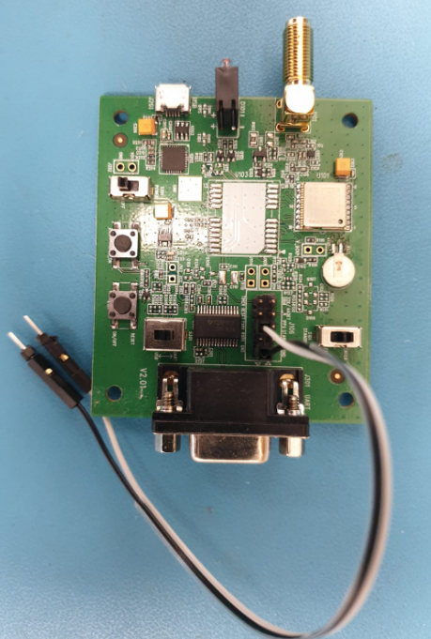
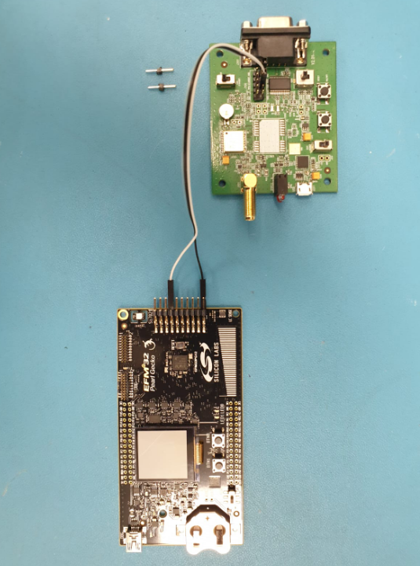
Guidance cont’d
Use the female-to-male converters that you’ve received with the GPS kit

Slide 13
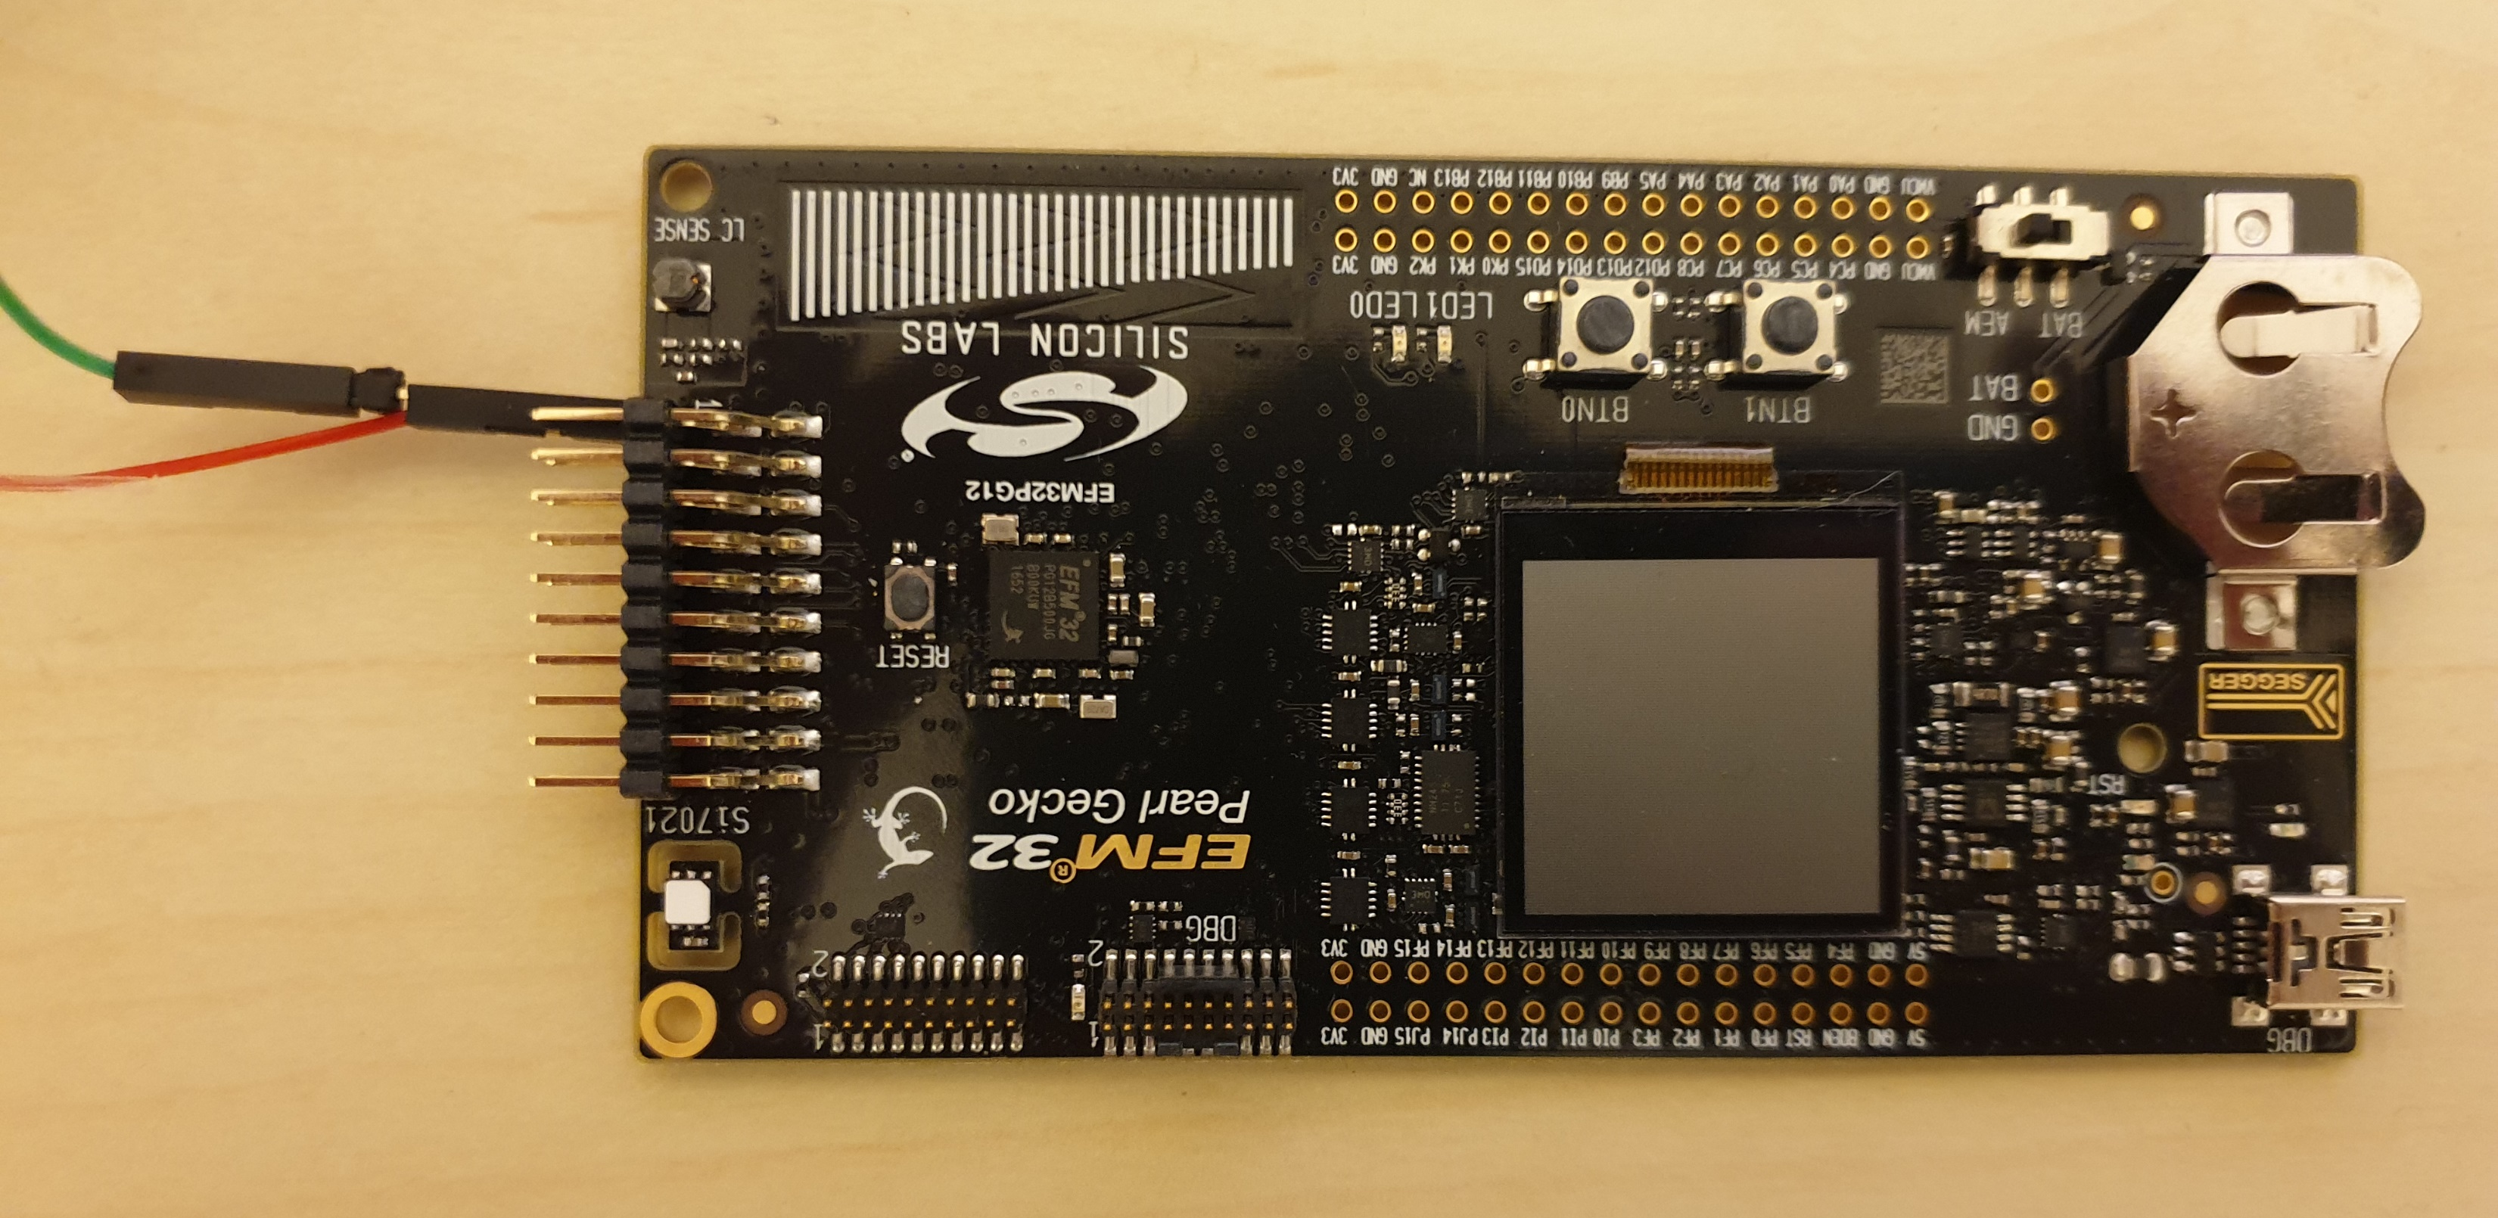
Guidance cont’d
Connect GND of GPS and modem together
GND A
|
female-to-male converter
|
GND B

Slide 14
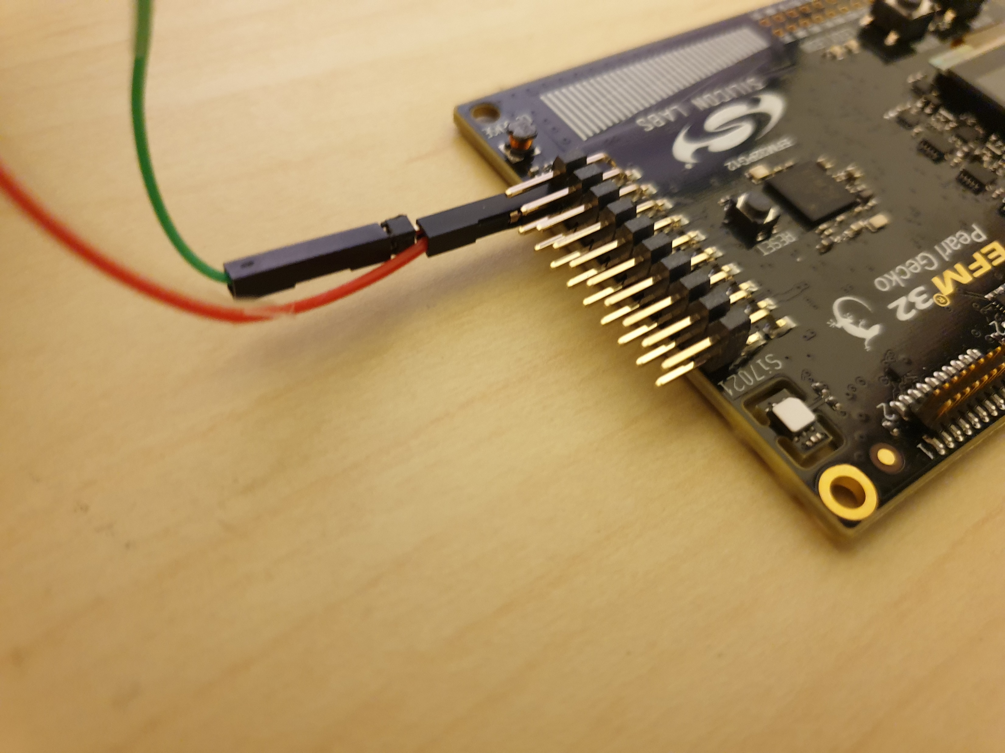
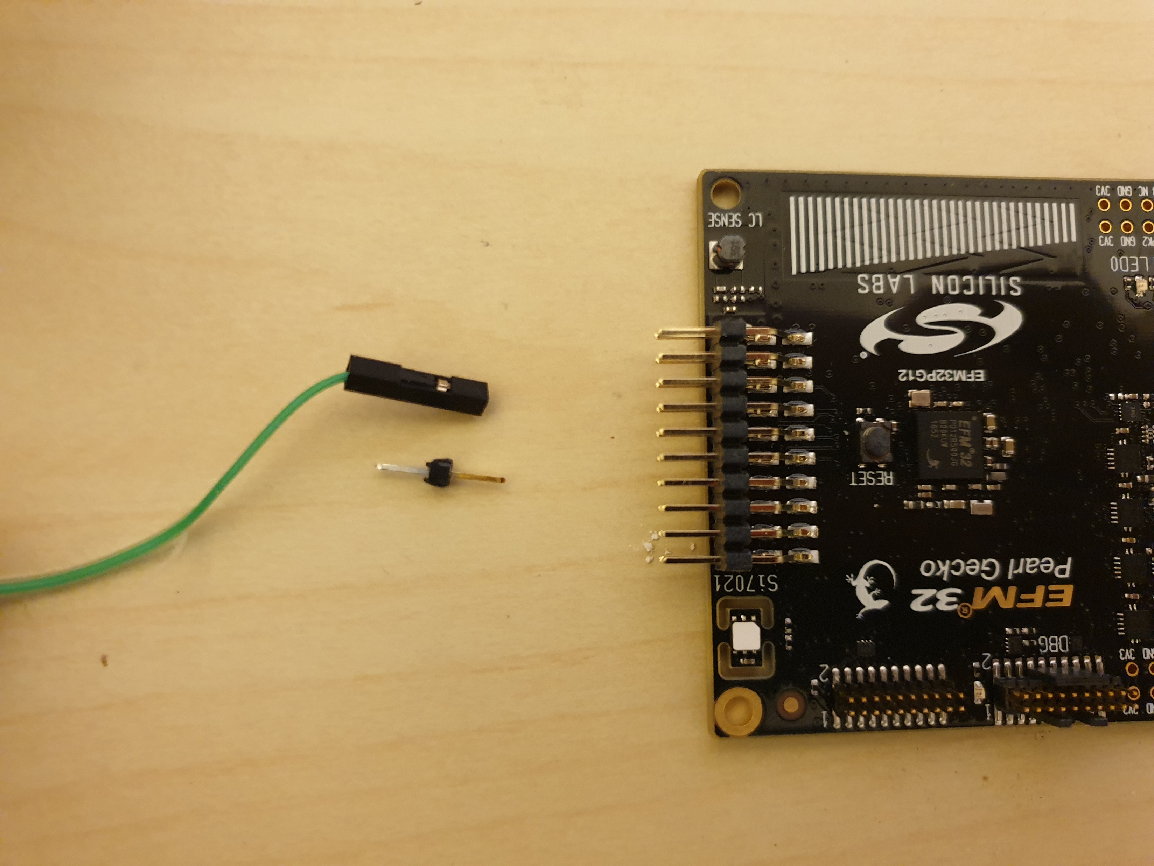
Guidance cont’d

Slide 15
Exercise #4
Work & submit in pairs
Deliverables:
Export and submit the protect (.sls file)
Compile and submit the .bin file
A README file with your names, email addresses, IDs, adequate level of documentation of the deliverables and software design-architecture-flow description
Pack all the deliverables as .zip or .rar and upload to Moodle
Deadline: 21.5.19, 10am
The grade will be based on code’s functionality and clear implementation

Slide 16
Contact
Moodle’s ‘Workshop Discussions’ forum is the best place for questions.
But if needed, contact us personally:
David Hay – dhay@cs.huji.ac.il
Yair Poleg – yair.poleg@mail.huji.ac.il
Samyon Ristov – samyon.ristov@mail.huji.ac.il

